Slide 1
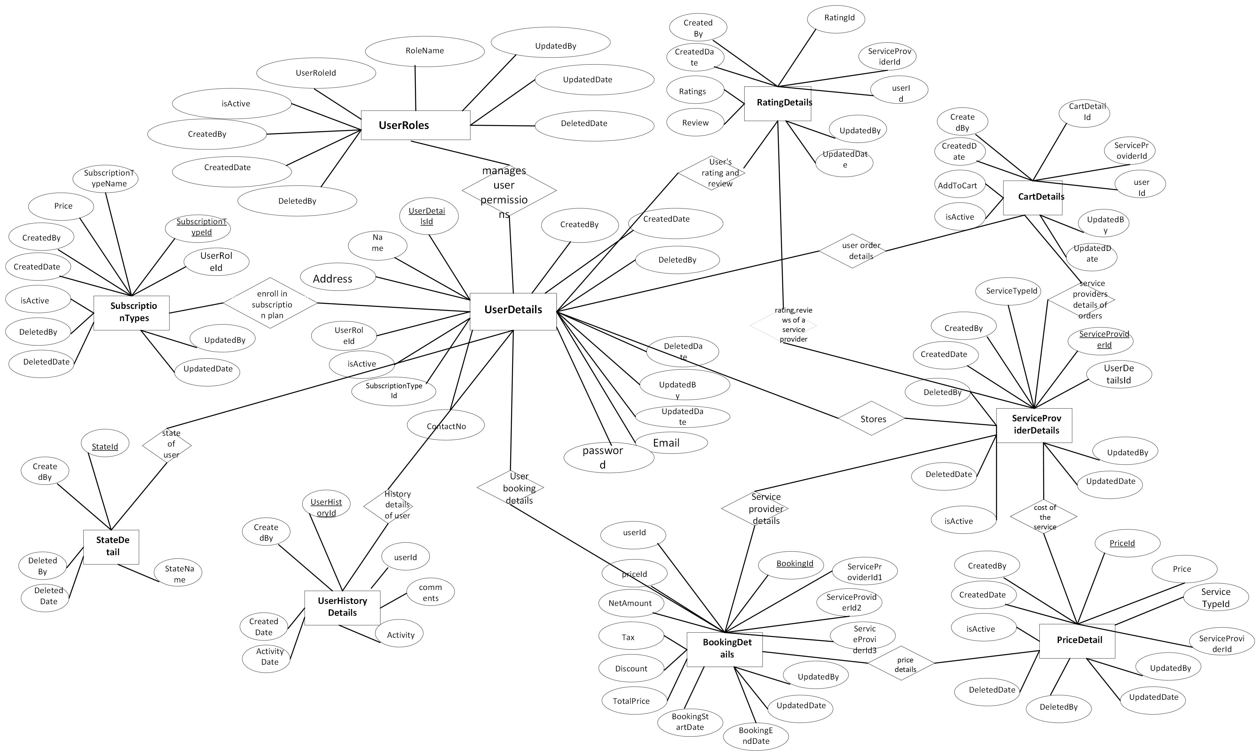
ER Diagram: MaidEase Iteration2

Slide 2
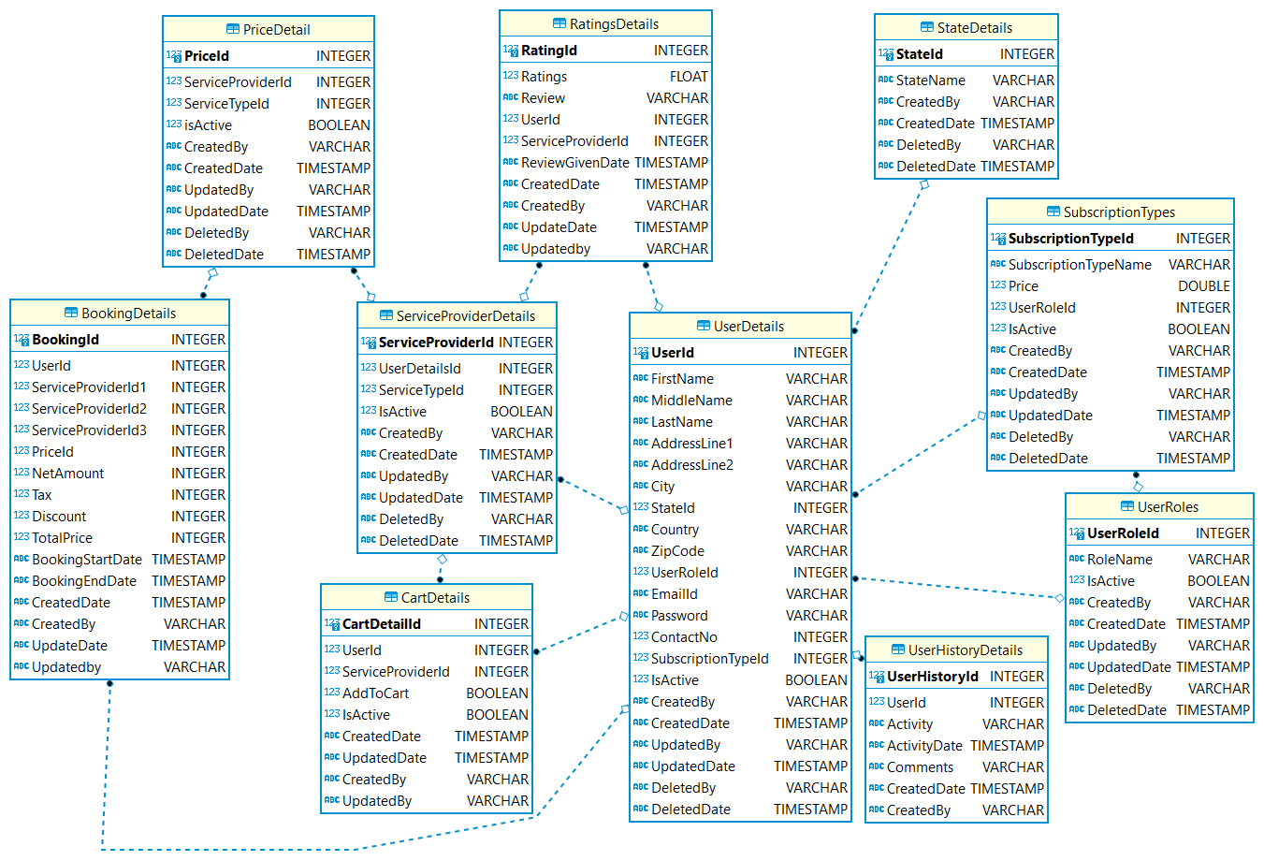
Logical Diagram: MaidEase Iteration2

